Slide 1
Parent Session Self Harm
Jenny Langley jenny.langley@charliewaller.org

Slide 2
Our vision
A world where people understand and talk openly about mental health, where young people and those who support them are equipped to maintain and enhance their mental health and wellbeing, and have the confidence to seek help when they need it.

Slide 3
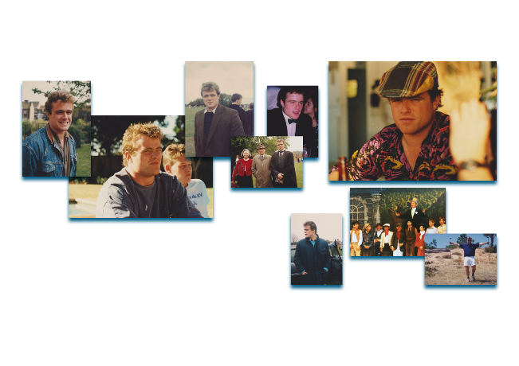
About us
Charlie Waller was a strong, funny, popular, good-looking and kind young man, with a close and loving family. To the outside world, he had everything to live for. Yet in 1997, at the age of 28, Charlie took his own life. He was suffering from depression.
In response to this tragedy, his family founded The Charlie Waller Trust, to open up the conversation around depression, and to ensure that young people are able to understand and look after their mental health and to spot the signs in others.
Charlie sits at the heart of our story, our vision and our purpose.

Slide 4
Working online
Zoom Functions
Camera on/off
Mute audio
Chat function
Hand icon
Chat rooms
Your Space
Comfort
Materials
Minimal distraction
Drink
Safe Participation
Confidentiality
Respect
Listen
Opt in
Opt out
Support

Slide 5
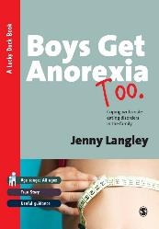
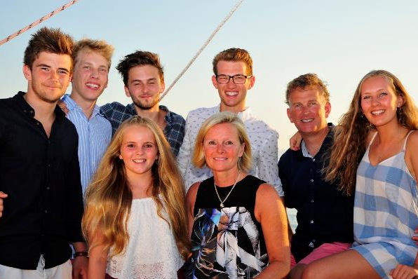
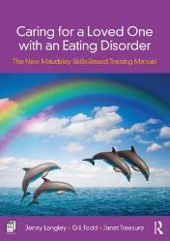

My kids – I have been a parent to teenagers for many years
Worksheets downloadable from
www.newmaudsleycarers-kent.co.uk

Slide 6
Outline of Session
What is self harm and why do young people adopt this as a coping strategy?
How to approach your child if you think they are self harming
How to respond if your child tells you they are self harming
Resisting the fix it urge – why just telling them to stop is unlikely to be effective
Seeking help for your child and your family
Awareness of medical risk and emergency first aid
Harm minimisation techniques
Looking after yourselves

Slide 7
Cutting, burning, embedding
Harm to oneself in order to cope
Overdosing, consuming poison
Scratching, banging
Punching, hitting, biting
Eating disorders, drugs, alcohol

Slide 8
Self harm can be direct or indirect
e.g. cutting vs risk taking
Self harm can be transient or longer term
Self harm is usually conducted at times of anger, distress, fear or worry…
…and is a way of coping with these feelings

Slide 9
Warning signs of self harm
Unexplained cuts, bruises, burns, broken bones
Keeping fully covered in all weathers
Sharp objects, blades, scissors routinely carried around
Blood stains on clothes, personal belongings, tissues
Social isolation
Evidence of changes to sleep or eating patterns
Low self esteem, irritability, mood swings
Poor performance in school work
Loss of interest in favourite hobbies or sports

Slide 10
Why do young people self harm?
Low self esteem
Bullying or conflict
Bereavement, parents’ divorce
Traumatic experiences, physical/sexual or emotional abuse
Being in the criminal justice system
Feeling rejected, poor self image, self-blame and punishment
To feel something, to exert control or manage suicidal thoughts
Alcohol and drug misuse
Pressure to do well at school
Have a learning disability
Problems to do with race, culture or religion
Unwanted pregnancy or concerns about sexuality
Being part of a normalising culture of behaviour, may also be influenced by media and peer groups
Poor body image
Exam stress
Peer pressure
Peer rejection/ bullying

Slide 11
Some of the Myths
People who self-harm are crazy
She chose to start, she can choose to stop
People who self-harm are doing it to fit in
Self-harm is attention seeking
People who self-harm are suicidal

Slide 12



Resisting the “fix it” urge Empathy – stepping into your child’s shoes
Why it is not helpful just telling them to stop
Red & Blue Balloon
Crap Day Exercise

Slide 13
You suspect your child is
self-harming..
What next?

Slide 14
Getting the your child to talk:
Could be one of the most difficult and most important things to do – often the first step in breaking the cycle
The reaction of others is seen as very important in the decision about whether to seek further help
Young people need to feel comfortable with who they speak to and often experience huge relief when they have shared their difficulties
Be patient and calm

Slide 15
Open the door
“Are you ok,
you seem a bit down,
I‘ve noticed xyz,
Your friends are worried…”
Keep the door open
I read an article about the impact of COVID on young people and ….
What would you say to a friend who is struggling?
You know I am here if you ever want to talk
Be patient and calm
Build trust

Slide 16
Useful phrases for the young person who is “fine” (pre contemplation)
You have been informed by another parent that James and a few other boys at the gym are thought to have been taking anabolic steroids. When questioned the boys are adamant that they are just taking protein supplements to build muscle and it is really helping. You can see that James is not his usual vibrant self.
“ You don’t seem yourself”
“I’ve noticed you are struggling and I’d really like to help you”
“If you had a magic wand how would your life be different”
“It must be baffling for you that we are all concerned, and from your point of view you are ok”
“It must be confusing for you when you think we are worrying unnecessarily”
“I’ve noticed you are and tired and out of sorts lately”

Slide 17









Using Motivational language to communicate with the anxious young person
1
Person centred
Open questions
Can you tell me what life is like right now?
How are you feeling, you seem a little down lately?
Affirmations
You are so hard working, resourceful, thoughtful, creative, inspiring
Reflections
You don’t seem yourself
I’ve noticed you are struggling and I’d really like to help you
You seem overwhelmed, exhausted, distressed
Summaries
Pulling the conversation together and planning the next chat
Boost self esteem
3
I am listening and noticing your feelings
Notes:
Open Questions
These invite students to talk and explore their own ideas and can help the teacher to understand more about how the student is really feeling
Affirmations
These help students to acknowledge their positive behaviours and character strengths, which then builds confidence in their ability to change. Affirmations also allow for recognition of the student’s difficulties, letting them know their concerns and issues are valid. Affirmations convey respect, understanding and support and need to be both genuine and appropriate
Reflections
By paraphrasing a student’s comment and repeating them back you can show you are really listening and seeking to understand what is being said. You can also seek to clarify issues you haven’t really understood.
Summaries
These pull together everything that has been discussed and again helps to reaffirm what has been said and to check that you fully understand the individual’s thoughts, desires and intentions.
It is recommended that you try to have 3 reflections for every open question. IE Listen more and say less and let the student speak.

Slide 18
Toolkit of Affirmations
Adaptable | Collaborative | Eloquent | Funny | Patient | Sociable
Amazing | Committed | Empathic | Hard working | Persevering | Sporty
Articulate | Compassionate | Energetic | Incredible | Popular | Strong
Artistic | Conscientious | Enthusiastic | Independent | Quirky | Talented
Attentive | Considerate | Expressive | Intelligent | Reflective | Thoughtful
Brave | Courageous | Fantastic | Kind | Resilient | Trust worthy
Calm | Creative | Fearless | Knowledgeable | Resourceful | Versatile
Capable | Determined | Flexible | Level headed | Responsible | Wild
Caring | Diligent | Fortuitous | Loving | Sensible | Wise
Clever | Driven | Friendly | Passionate | Sensitive | Zany

Slide 19
Useful phrases for the young person who is “fine” – to keep connected and build trust
“You are determined and strong and I am interested to hear your thoughts on balancing your training and workload”
“You have become much stronger this term, and I’ve noticed you are taking your training very seriously.”
“What would your top training tips be for a younger student?”
“I’ve noticed you have stopped training with your pals”
“Tell me the things that motivate you”
Make sure you pay attention to what is going well for your child, as well as noticing what might not be going so well

Slide 20
You child tells you they are
self-harming..
What next?

Slide 21
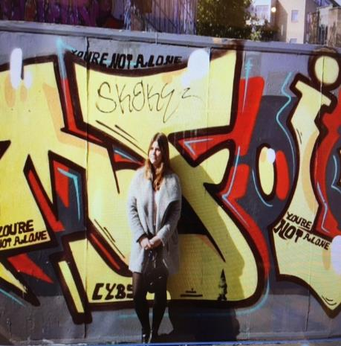

No Harm Done – Leaflets & Videos
No Harm Done – video and leaflet for parents created by Young Minds, Charlie Waller Trust and Royal College of Psychiatrists
Advice and support for parents or carers of self-harming children (charliewaller.org)
http://www.youngminds.org.uk/noharmdone

Slide 22
Shock
Confused
Anger
Devastation
You discover your child is self harming and you feel overwhelmed with emotions.
You might feel a sense of failure – why didn’t I see this coming? Could I have protected them better?
Shame/ guilt
Sadness
Disbelief
Why?

Slide 23

Practical tips for building trust with your child
It is important to get professional help (if you can) First port of call is the GP
Before I didn’t have aspirations, now I see a future
I knew about self harm but didn’t expect it to happen to my little one
I don’t want to be watched constantly. I don’t want people to see me as that person
It has to be when she is ready and on her terms. That is hideously hard
It was such a weight off my shoulders, being able to communicate more with my family has been a very positive thing
Trust yourself, you are ok as a parent. Just keep talking that is fundamental
My mum & dad accepted it, they didn’t shout. They gave me support. I will be forever grateful

Slide 24
Tips from young people:
Try not to judge
Be honest “I don’t understand but I do want to help”
Accept recovery is a process – it will take time
LISTEN and listen and listen
Talk about other things too – what are you proud of?
Be patient and calm

Slide 25
Self harm is a coping strategy Once you have built that trust Be curious not furious.
Help me understand what are the positive benefits of your self harm behaviours?
It gives me control
I am good at it
I get attention – it is the only way I can communicate my distress
It makes me feel euphoric
It is my release
It makes me calm and focused
The physical pain is easier to bear than the emotional pain
It wipes away bad feelings
It makes me feel alive
It keeps me alive, without it I would die
I like the sight of blood, it makes me feel alive

Slide 26
“My mum took the time to listen. Really listen.
She made time for me.
I was the most important thing she had to do right then.
It made me feel special and allowed me to open up to her.”

Slide 27
More thoughts from young people
Everything going on inside me is really ugly and really scary
To have that trust is absolutely crucial
There are hard days but there is always light at the end of the tunnel when you have someone you trust
If you react badly to what is on the outside I am not going to show you what is on the inside.

Slide 28
Practical tips when responding to a self harm injury
Is there an immediate need for medical care?
Is the child a danger to themselves?
What message do you want to give to the child?
Notes:
Arrange appropriate (medical) care:
In the case of an overdose, advice must be obtained from A&E department - call an ambulance if needed.
Arrange appropriate medical care/first aid
If you are concerned that an episode is a serious attempt of the young person to end their life, contact your local CAMHSservice
To people delivering this training, please can you add relevant local contact details here please

Slide 29
Is there an immediate need for medical care?
First Aid first
A&E if needed
Wound manage
ment
Notes:
Arrange appropriate (medical) care:
In the case of an overdose, advice must be obtained from a GP or A&E department - call an ambulance if needed.
Arrange appropriate medical care/first aid
If you are concerned that an episode is a serious attempt of the young person to end their life, contact your local CAMHS Tier 3 Team Duty Line immediately
To people delivering this training, please can you add relevant local contact details here please

Slide 30
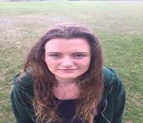
What message do you want to give your child?
Hayley shows you fresh cuts on her arms.
They look clean and shallow and she has no visible signs of shock.
Thank you for telling me/ showing me
You are not in trouble
We are here to help you
Notes:
Arrange appropriate (medical) care:
In the case of an overdose, advice must be obtained from a GP or A&E department - call an ambulance if needed.
Arrange appropriate medical care/first aid
If you are concerned that an episode is a serious attempt of the young person to end their life, contact your local CAMHS Tier 3 Team Duty Line immediately
To people delivering this training, please can you add relevant local contact details here please

Slide 31
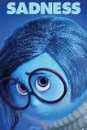

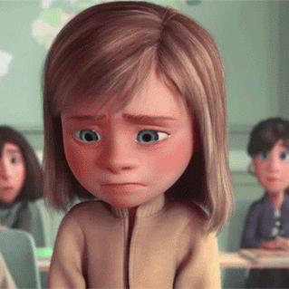

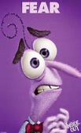
Noticing and validating emotions can really help
What to Say to Kids When Nothing Seems to Work: A Practical Guide for Parents and Caregivers: Amazon.co.uk: Lafrance, Adele: 9781138344631: Books
Emotion-Focused Family Therapy - Based on the healing power of connection. (emotionfocusedfamilytherapy.org)

Slide 32


ALVS (Emotion focused reflection)
You were so shocked to discover that Hayley had cut herself that you panicked and said in a distressed tone “Hayley what have you done?”
Much later you try to reconnect using ALVS
“You are not listening to me and you don’t understand me and I hate you” exits slamming the door
Attend – to visible signs of distress
I can see my reaction to you earlier was really unhelpful and you really slammed the door when you left the room
Label – guess the emotion
I am guessing you were angry and frustrated
Validate – you are feeling this way because………
I am guessing you were angry because you feel I was not listening, and frustrated because I don’t understand you. I would feel angry and frustrated if I felt nobody listened or understood.
Soothe – each emotion has a corresponding need from the environment.
For example anger – space, sadness – hug. Soothing responses might also be distractions, affirmations, joint goal setting.

Slide 33
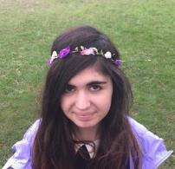
Using ALVS in a crisis situation
Sophia comes to you crying and clearly very distressed.
She says she has taken a packet of paracetamol but she doesn’t want to die.
Attend – Sophia thank you for telling me, I can see how upset you are
Label – you seem really anxious and absolutely terrified
Validate – you are feeling this way because……… you have taken paracetamol and you are scared about what is going to happen next. These are normal feelings for somebody in this position.
Soothe – I am going to help you. This is what is going to happen next. I will make sure somebody is with you every step of the way. We will take one minute at a time.

Slide 34
Using ALVS when a student is in two minds
James has started to trust you more, that you won’t judge or criticise him. He has disclosed that he is now taking anabolic steroids and has become very upset. He refuses to look at you, and is tearful
Attend – James I notice that you are avoiding eye contact with me and it looks like you are feeling upset
Label – you seem sad and anxious at the same time
Validate – you are feeling this way because………you have opened up to me about your steroid use and you don’t know what is going to happen next. These are normal feelings for somebody in this position.
Soothe – Thank you for telling me. It is a very courageous thing to do and I am so pleased you feel you can trust me. You are not in trouble, you are safe in this family and we can help you.

Slide 35
Using ALVS when your child is in two minds
Soothe – We are here to help and support you. There are several options and we can make a plan together (self help and online support, GP, sports coach, private counsellor) I have been reading about things that have helped other families.
Would you like me to describe some of the things that have worked for them ( reduce anxiety and increase hope) or would you like some space to think about what you would like to happen next (let the emotions dissipate )?
We can always talk about this next week. I know you usually go to drama club at this time (distraction) and you are such a good role model to the younger kids.(affirmation)

Slide 36
Using ALVS after a crisis has subsided
Sophia is home from the hospital and thank fully has not suffered any long term effects from the paracetamol overdose. She asks you to help her to get back on track, she tells you she has lost her self confidence and often gets overwhelmed with negative thoughts
Attend –You feel overwhelmed with negative thoughts and you have lost your self confidence
Label – you seem extremely anxious and depressed at the same time
Validate – you are feeling extremely anxious because you have become distant from your friends since COVID and you don’t know how to get that friendship back. You are feeling depressed because you haven’t been able to do your acrobatics and dance since COVID and that was always the thing that made you feel a sense of belonging and also a sense of achievement.
Soothe – Lots of young people are really struggling at the moment, you are not alone. We are here to help you get your life back on track. You are such a talented girl and your friends have always valued your sense of fun and adventure. Lets make a timeline for the next few months so you can start to visualise happier times ahead.

Slide 37


Summary
Things to avoid:
Criticism
Hostility
Arguments
Judgement
“I think you should ...”
Instead:
Listen
Reflect back
Show empathy
Notice emotions
Drip feed affirmations
Ask open questions
Be curious not furious
Strike when the iron is cold
Give more attention to the behaviours you like …
You can still agree boundaries and be firm with negative behaviours

Slide 38
The next stages:
1
Offer practical support
2
Involve your child in decisions
3
Look after your own wellbeing

Slide 39
WHAT to tell them
WHO to tell?
HOW to tell them
Next steps
Goal setting
Involve your child

Slide 40
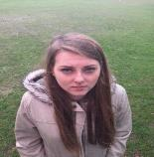
You have built trust with Hayley and she is now ready to look at possible alternatives. She asks you to help her come up with a list of options and you both research this together.
Hayley agrees to try one or two of the following:
Create a crisis card with the aim of delaying the urge to self harm when her anxiety is building
Create a safety plan BlankSafetyPlan.pdf (stayingsafe.net)
3. Create a list of healthy alternatives to self harm and consider trying to introduce one new healthy option a week for the next four weeks
4. Create a self soothe box HOPEBOX resource (papyrus-uk.org)
4. Try out an NHS app Home - Calm Harm App
Have a check up with the GP and enquire if there is any possibility of therapeutic support from CAMHS (this might not be available in your area). East Sussex Single Point of Advice (SPoA) | Sussex Partnership NHS Foundation Trust
6. Research private therapists who have expertise with self harm and who practice dialectical behavioural therapy as you have discovered that this is a really effective treatment that looks to validate difficult emotions

Slide 41
A Crisis Card can really help
Things I can do at home
When I feel really anxious or stressed I will…
1. Do 17x table
2. Text my Mum/ a friend
3. Eat something really sour
4. Watch Youtube videos of mini dachshunds
5. Go to student support
5. Call a helpline
Things I can do at School
Things I can do if I am out with friends
Notes:
Write notes here

Slide 42
Explore alternatives to unhealthy coping strategies

Slide 43
Some self-harm minimisation strategies
Delay urges to self-harm for 10min, monitor feelings and what helps (or even by one minute to start)
Kick and punch something soft, like a pillow
Pinch the skin instead of cutting
Physical exercise/exertion, such as walking, tidying
Shout, scream or sing loudly to music
Draw on body with red pens/paint (instead of seeing blood)
Squeeze ice for a short time (instead of burning)
Carry safe things to squeeze e.g. tennis ball, stones
Use creativity – try to distract from self-harm or increase good feelings, with yoga, hobbies, talking to friends, phone support lines

Slide 44
130 ideas powerpoint
Ideas that simulate self harm
Ideas for when you need to vent your feelings
Ideas for when you feel alone or down
Ideas for when you need a distraction
Delaying tactics to give you a short time to think
Ideas to help you feel more in control
Ideas that remind you that you have a future
Ideas for when you’re confused
Ideas that nurture rather than harm
Ideas that remind you that you’re real
Ideas that won’t be noticed in busy situations
Notes:
In presentation mode, these titles all act as hyperlinks to the relevant slide

Slide 45
If you remember 3 things…
1
2
3
Self-harm is a coping mechanism
Trust your gut. If you’re worried, follow up
LISTEN & ask ‘How can I help you?’

Slide 46
Supporting yourself:
It is extremely important to look after yourself
Notice and validate your own emotions
Accept recovery is a process – it will take time and you need to be physically and mentally well
Wellbeing basics: healthy eating, sleep, regular exercise, connecting with others
Schedule fun activities with all members of your family
Role model self care

Slide 47
Further Resources for young people who are self harming
No Harm Done – video and leaflet for young people created by Young Minds, Charlie Waller Trust and Royal College of Psychiatrists
Alumina, is a 7 week course offered online (& free!) for 14 – 19 year olds - by SelfharmUK https://www.selfharm.co.uk
Calm Harm app - NHS (www.nhs.uk)
DBT is a type of talking therapy that's often effective in people with mood disorders. The app provides tasks that encourage users to distract themselves from urges to self-harm and help manage their "emotional mind" in a more positive way.
Can I Tell You About Self Harm by Pooky Knightsmith
https://www.amazon.co.uk/Can-Tell-You-About-Self-Harm/dp/1785924281/ref=pd_lpo_sbs_14_img_1?_encoding=UTF8&psc=1&refRID=Q69XFDX9GBJ6VE34N74J

Slide 48
Further Resources for Parents
No Harm Done – video and leaflet for parents created by Young Minds, Charlie Waller Trust and Royal College of Psychiatrists
Advice and support for parents or carers of self-harming children (charliewaller.org)
Cutting Down by Lucy Taylor, Mima Simic and Ulrike Schmidt
A CBT workbook for treating young people who self-harm
Downloadable worksheets can be found at https://www.routledge.com/Cutting-Down-A-CBT-workbook-for-treating-young-people-who-self-harm/Taylor-Simic-Schmidt/p/book/9780415624534 under eResources.
Self Harm and Eating Disorders in Schools by Pooky Knightsmith
https://www.amazon.co.uk/Self-Harm-Eating-Disorders-Schools-Knightsmith/dp/184905584X
Can I Tell You About Self Harm by Pooky Knightsmith
https://www.amazon.co.uk/Can-Tell-You-About-Self-Harm/dp/1785924281/ref=pd_lpo_sbs_14_img_1?_encoding=UTF8&psc=1&refRID=Q69XFDX9GBJ6VE34N74J
Validating Emotions
Parenting a Teen Who Has Intense Emotions: DBT Skills to Help Your Teen Navigate Emotional and Behavioral Challenges by Pat Harvey https://www.amazon.co.uk/gp/product/1626251886/ref=ppx_yo_dt_b_asin_title_o09_s00?ie=UTF8&psc=1
What to Say to Kids When Nothing Seems to Work: A Practical Guide for Parents and Caregivers eBook: Lafrance, Adele, Miller, Ashley P.: Amazon.co.uk: Kindle Store

Slide 49
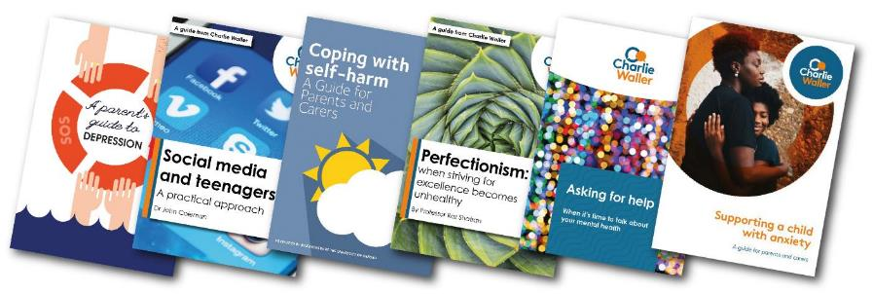
Free information booklets
Free resources for parents, professionals and others interested in mental and emotional wellbeing
Free practical mental health resources | Charlie Waller Trust

Slide 50
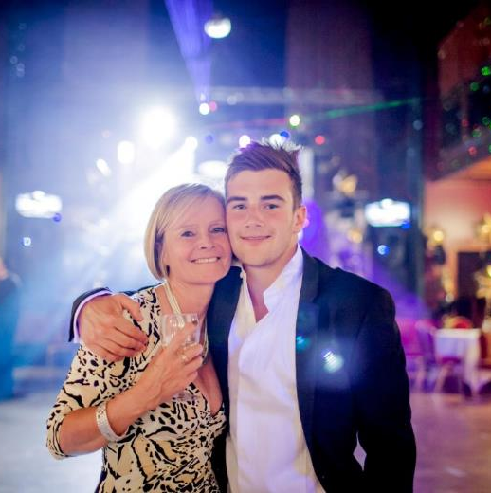

Slide 51
Thank you for listening
The Charlie Waller Trust
First Floor, Rear Office • 32 High Street Thatcham • Berkshire RG19 3JD
01635 869754 • hello@charliewaller.org

Slide 52
Please consider donating to help us continue our support
To donate £10 text
CWT to 70085
To donate online visit
charliewaller.org /donate

